Slide 1
Integrated curriculum
Kadian O. Coote

Slide 2

Research base and literacy lesson plan

Slide 3
Earth/Environmental Science with English Class Size: 20 Students Grade Level: 9th Duration: 120 Minutes
Learning Target: Today we will learn about renewable energy sources, energy resource extraction and the R.A.C.E. strategy.
Standards:
EEn.2.2. Understand how human influences impact the lithosphere.
EEn.2.8 Evaluate human behaviors in terms of how likely they are to ensure the ability to live sustainably on Earth.
Lesson Objectives:
EEn.2.2.2 Compare the methods of obtaining energy resources and their impact on the environment.
EEn.2.8.1 Evaluate alternative energy technologies for use in North Carolina.
I Can:
Describe energy resource extraction and their environmental impact.
Critique the benefits, costs, and environmental impact of various alternative sources of energy for North Carolina.
Evaluate which sources of alternative energy may work best in different parts of the state and why.
Have class discussion and work collaboratively showing respect for each other.

Slide 4
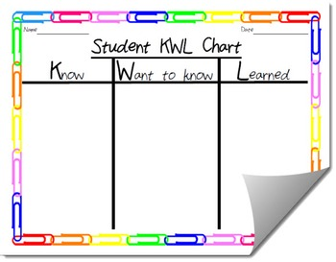


Essential Vocabulary
Energy
Alternative energy (renewable energy)
Wind energy
Geothermal energy
Hydropower
Non-renewable energy
Natural gas
Peat
Drilling
Harvesting
Mining
Learn About It
The students will view a power point presentation on energy resources to learn about alternative energy sources and how they are extracted.
This Photo by Unknown Author is licensed under CC BY
Do Now
Students will record what they know and want to know about energy sources on a KWL form.
This Photo by Unknown Author is licensed under CC BY-SA-NC
This Photo by Unknown Author is licensed under CC BY

Slide 5
Practice It - Guided
The students will complete an activity on advantages and disadvantages of renewable energy. activity. The teacher and students will discuss the responses using the following questions.
1. How does renewable energy differ from non-renewable energy?
2. Which energy source is more economic? Give reasons for your answer.
3. If you were to use renewable energy for your home environment, which would it be and why?
4. Why is it necessary to extract some energy resources given the negative impact on the environment.
Practice It - Collaborative
The teacher will write the pairs of energy resources in. North Carolina on the white board.
Energy Resources Pairs Coal and Natural Gas Wind and Solar Petroleum and Nuclear Geothermal and Hydroelectricity
From the list, the students will choose the resources they want to learn about.
The teacher will place students in groups according to the selected resources and academic abilities.
The students will work in their groups to research the chosen resource and prepare a presentation. The students will choose how to present their research. The presentation must highlight;
The resource extraction methods
The advantages and disadvantages of using the resources.
The environmental effect of extracting and using the resources.
The groups will present their research findings to the class so that the other groups can learn about the energy resource researched.
Independent
The students will complete the learned section of the KWL chart highlighting five key points.

Slide 6
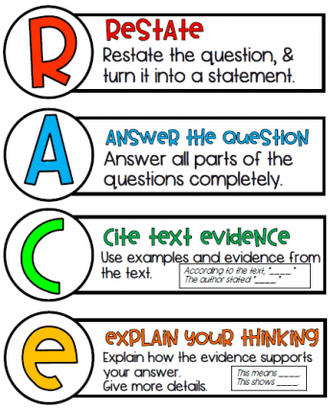
Evidence of learning
The students will answer the question: Which alternative energy source is best suited for Bertie County while using evidence from the lesson to support their answer.
The teacher will model using the R.A.C.E. strategy for the students before they answer the question.

Slide 7
Assessment of the Integrated Lesson for Online Learning and Multiple Categories of Learning Preferences
Lesson Components | Online Learning | Visual Learning | Auditory Learning | Kinesthetic Learning
Do Now and Independent work | The students can complete the KWL form via Padlet or Google form. The students can complete the R.A.C.E. activity suing a google doc. | Make KWL chart visually appealing with vibrant colors. | Students can access read aloud application to read words and instructions aloud. | The students can record their responses via the Padlet or Google form or on a hard copy of the KWL form.
Whole Group | Students can access PowerPoint presentation using Chromebook. The teacher can use online platforms such as Kahoot or Padlet to ask questions. | The teacher incorporate images in the presentation to help students with grasping the content. | The teacher can add audio to the presentation and students will have unlimited access. | The students can record key take away form the PowerPoint presentation.
Small Group | Students will get information on their energy resource by searching the internet and the teacher can use breakout rooms for grouping. | The student can be in charge of creating the visuals for the presentation. | The teacher and other group members will read the assignment instructions as well as the students can use read aloud application to read information researched. | The students can be the note taker or time-keeper. The student can also be in charge of putting the presentation together.

Slide 8
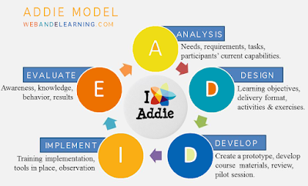
Analysis of Lesson Plan Using Addie
Analysis, design, development, implementation, and evaluation (ADDIE) are the five steps of the instructional development process (Yeh & Tseng, 2019). Educational course materials and educational training programs are designed by instructional designers and content producers (Lasky, 2020).
This Photo by Unknown Author is licensed under CC BY-SA-NC

Slide 9

Analysis
Audience: 9th grade students with divers learning abilities.
Outcomes: Improved research and critical thinking skills, understanding of energy sources and relevance to life and impact on environment.
Constraints: autonomy to choose presentation format and life experiences related lesson.
Delivery and Online Considerations: Visual-PowerPoint, audio- teacher presentation and online read aloud application, and Chromebook (Kinesthetic) – research.
Resources: Chromebooks, internet access, R.A.C.E. Strategy and KWL chart.
This Photo by Unknown Author is licensed under CC BY

Slide 10

Design
The major goal of this phase is to create a plan for the lesson's instructional material (Lasky, 2020).
Objectives:
Compare the methods of obtaining energy resources and their impact on the environment.
Evaluate alternative energy technologies for use in North Carolina.
Instructional Strategy: Brainstorm using KWL, whole group discussion, and cooperative grouping.
Assessments: Research presentation and application of knowledge using R.A.C.E. strategy.
This Photo by Unknown Author is licensed under CC BY

Slide 11

develop
The module is created in the developing phase using given learning objectives, techniques, and activities (Ab Latif & Mat Nor, 2020). Students' critical thinking and knowledge application abilities are being developed through the learning goals.
The below occurs;
Collaborative grouping from topic selection.
Groups deciding how to present research finding.
Apply knowledge through R.A.C.E strategy.
This Photo by Unknown Author is licensed under CC BY-SA-NC

Slide 12

implementation
The teacher takes an active part in the implementation phase to achieve excellent outcomes (Ab Latif & Mat Nor, 2020).
The learn about it activity leads to the implementation of the body and culmination of the lesson.
Observing groups while working on research and providing needed assistance will aid lesson progression.
This Photo by Unknown Author is licensed under CC BY

Slide 13

evaluation
Students take an assessment during the evaluation phase to determine if the learning process went as planned, and the objective was achieved (Lasky, 2020). Evaluation also provides an opportunity to identify strengths and shortcomings. Clear objectives and job instructions, as well as the inclusion of diverse learning styles, are among the strengths. Time to design lessons and group supervision during research are disadvantages, as the teacher can only assist one group at a time, and some students may become dissatisfied if they do not receive assistance immediately.
This Photo by Unknown Author is licensed under CC BY-SA-NC

Slide 14
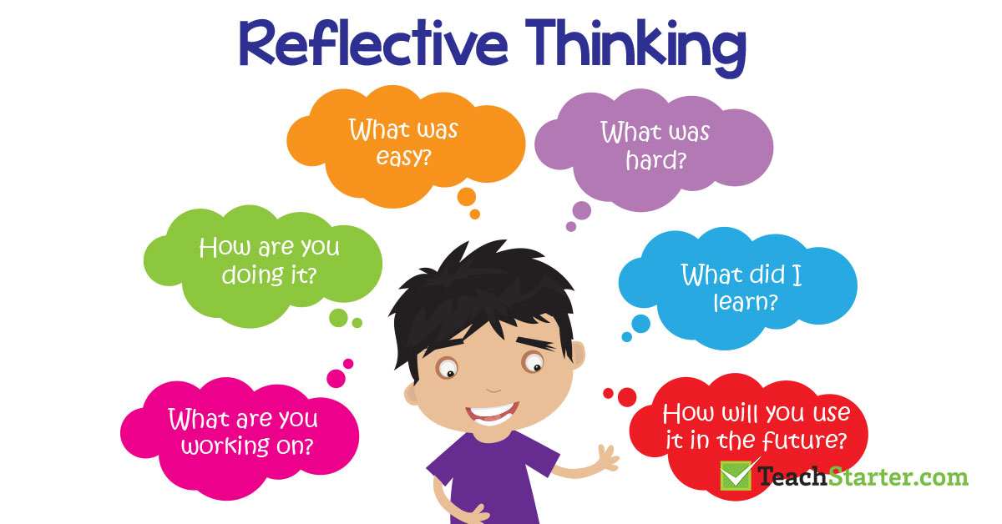
Reflection
An integrated lesson covers contents from more than one subject area. Generalized content can be merged (Merritt, 2021). Science teachers can combine lessons with mathematics or English content. However, to integrate and execute lessons, educators must know students learning needs as well as their cultural and ethnic needs. Aligning lessons to students learning needs while incorporating culture allows students to grasp and retain information better (Campbell, 2021). Integrating the lesson plans has given me an insight into the various aspects of preparing lessons for diverse learners.
This Photo by Unknown Author is licensed under CC BY

Slide 15
references
AB LATIF, R., & MAT NOR, M.,Zarawi. (2020). Using the ADDIE model to develop a rusnani concept mapping guideline for nursing students. Malaysian Journal of Medical Sciences, 27(6), 115-127.
Campbell, J. (2021). Culturally responsive teaching (CRT). Salem Press.
Lasky, J. (2020). ADDIE model. Salem Press.
Merritt, R. D. (2021). Integrated curriculum. Great Neck Publishing.

